Slide 1

Newly approved therapies for METex14 and METamp lung cancers
Xiuning le md phd (MD Anderson Cancer Center)
Rebecca heist MD mph (Mass general hospital)
andreas saltos MD (moffitt cancer center)
john hallick (MET crusaders)
Title Slide – Single Presenter

Slide 2
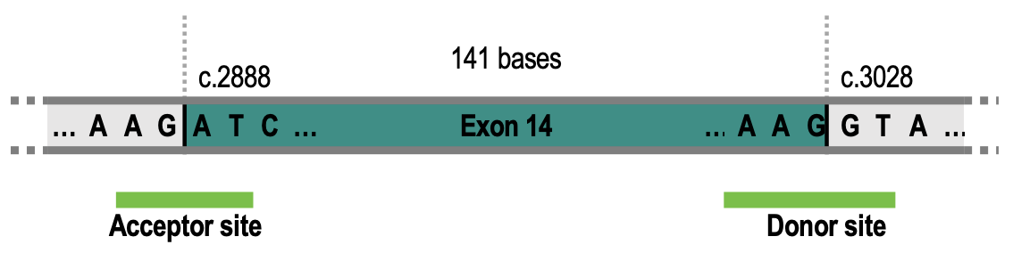
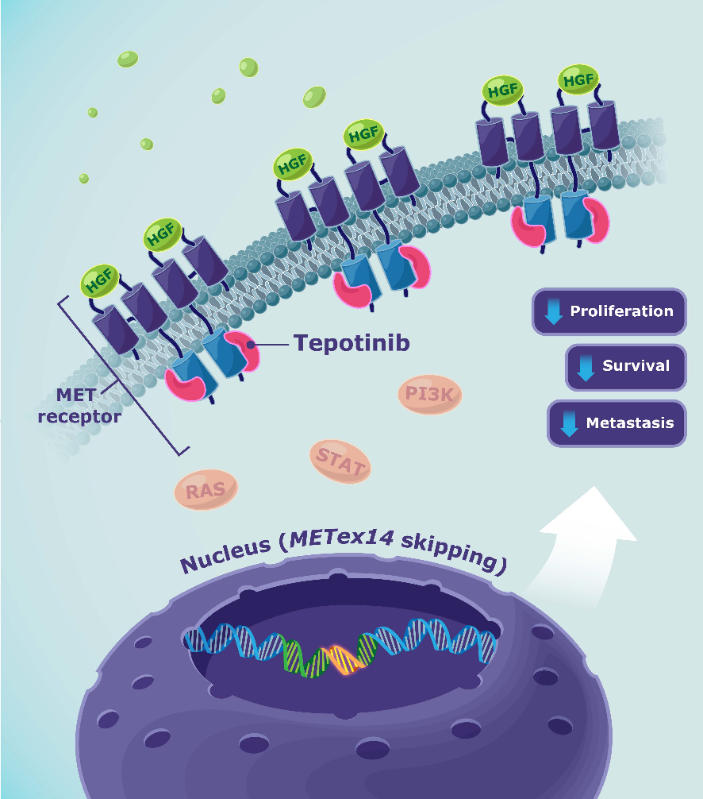
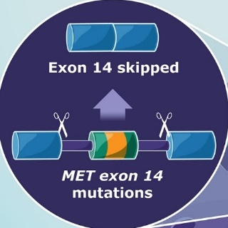
METex14 as an oncogene driver in lung cancer
MET exon 14 skipping
Chr7:116411903
c.2888
Chr7:116412043
c.3028

Slide 3
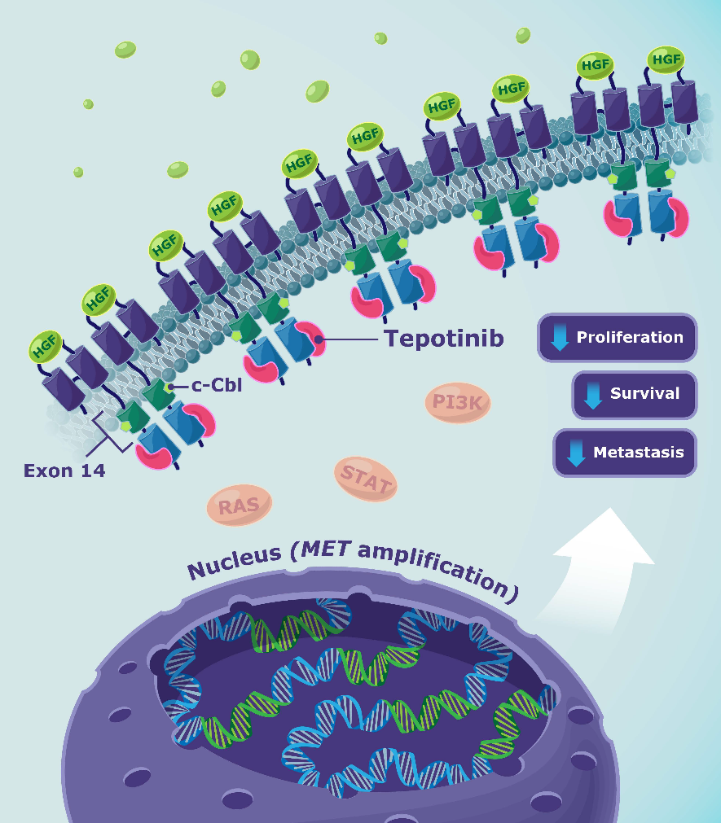
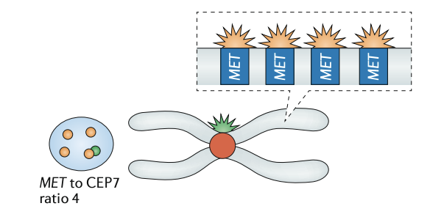
MET amplification in lung cancer
Focal amplification of MET can lead to MET pathway activation and oncogene dependency in lung cancer
MET amplification

Slide 4
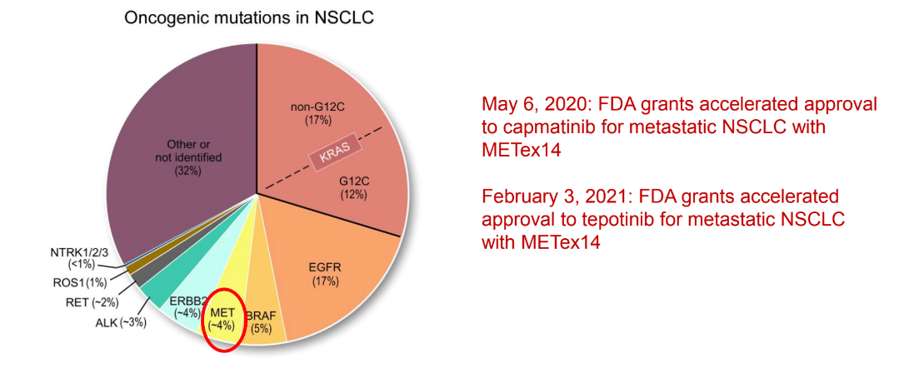
METex14 and METamp in lung cancer
METex14 in about 3% of NSCLC
High copy-number gain of MET in about 1% of NSCLC
Both tissue-based and blood-based next-generation sequencing can detect MET changes.

Slide 5
The patents and needs
 | EGFR-mutant | ALK- rearranged | General NSCLC | METex14
Median age | ~60 (57-64) | ~ 53 (50-57) | 70 (USA) | ~71 (69-74)
Female | 62-80% | 60% | 40% | 50% (45-50%)
Smoking Hx | 7-37% | 35% | 75% | 42-62%
PDL1 high | Rare | Rare | 25-40% | 41%
Non-adeno path | Rare | Rare | 30-40% | Up to 26%
Challenges:
Testing in this population who has similar features to general NSCLC
How to select treatments for this elderly population
How to mitigate side effects from therapies and best serve those patients

Slide 6
FDA approved MET therapies
Content Slide – Title Only

Slide 7
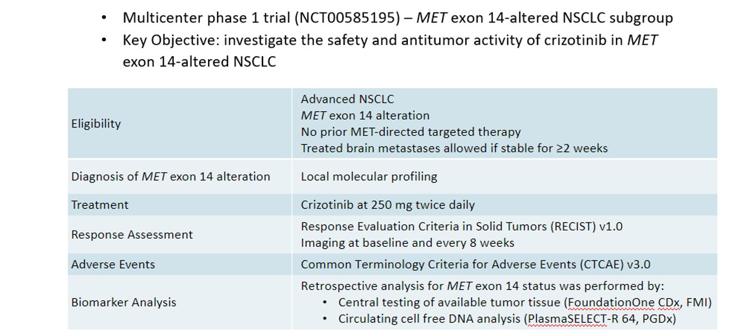
Crizotinib PROFILE 1001 Study Design
Drilon et al WCLC 2018

Slide 8
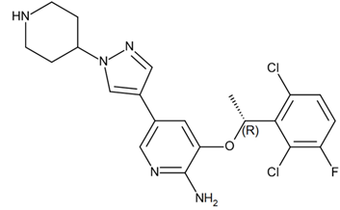
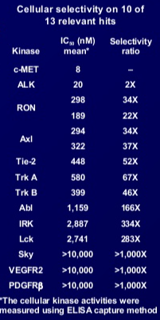
Crizotinib activity in METex14
ORR 32%
mPFS 7.3 mo
Bang et al ASCO 2010; Drilon et al, Nat Medicine 2019

Slide 9
Crizotinib activity in MET amplified NSCLC
Camidge et al, ASCO 2014

Slide 10
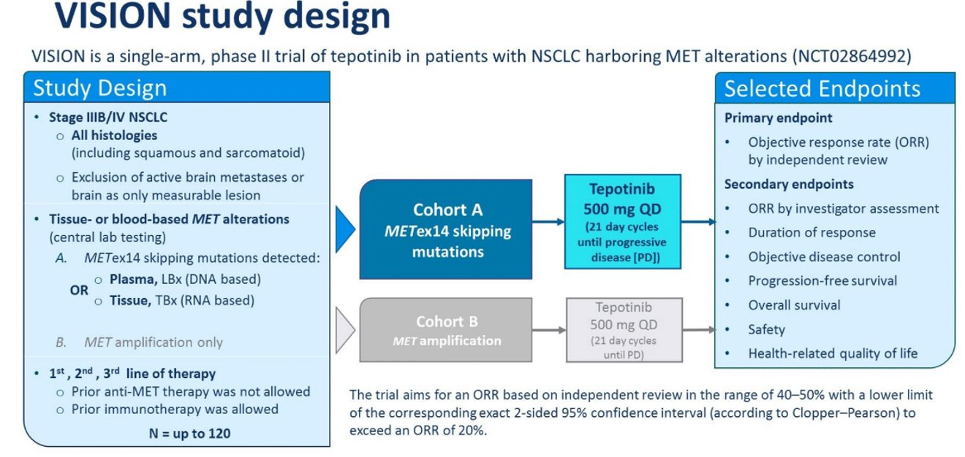
Tepotinib VISION study design
Paik et al ASCO 2019

Slide 11
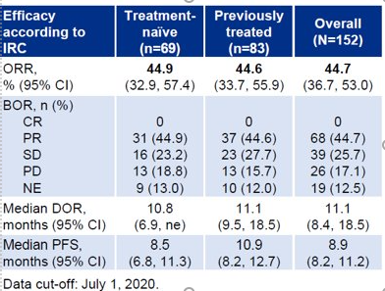
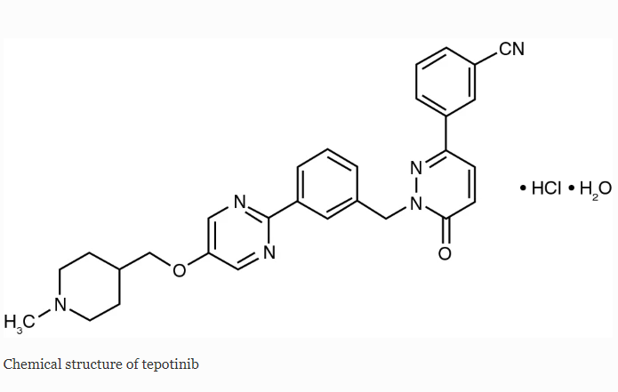
Tepotinib activity in METex14
ORR 46%
mPFS 8.5 mo
Bladt et al CCR 2013; Paik et al NEJM 2020; Paik et al WCLC 2020

Slide 12
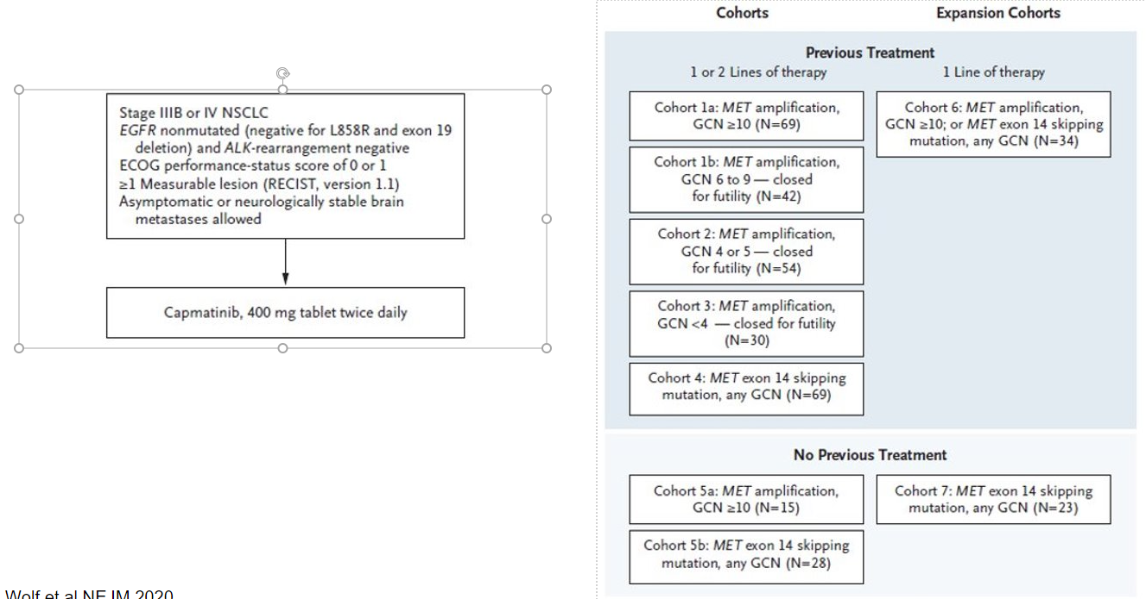
Capmatinib Geometry mono-1 Study design
Wolf et al NEJM 2020

Slide 13
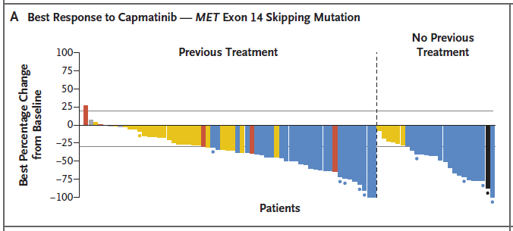
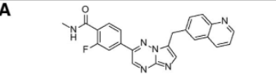
Capmatinib activity in METex14
ORR 41%
mPFS 5.4 mo
ORR 68%
mPFS 12.4 mo
Baltschukat et al CCR 2019; Wolf et al NEJM 2020

Slide 14
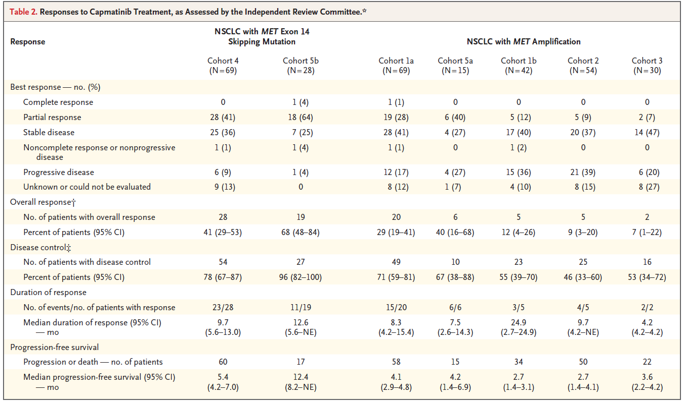
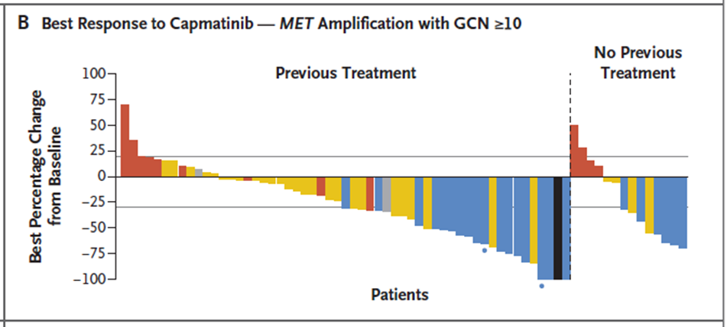
Capmatinib in MET GCN cohorts
ORR 29%
ORR 40%
Wolf et al NEJM 2020

Slide 15
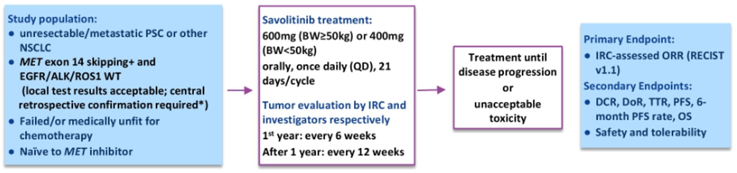
Savolitinib NCT02897479 study design
Lu et al, ASCO 2020

Slide 16
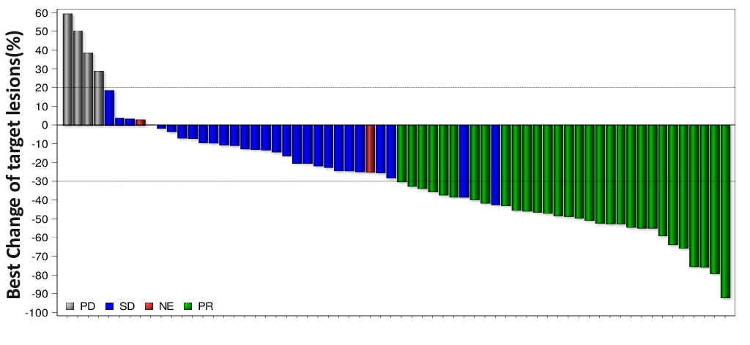
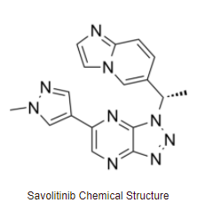
Savolitinib activity in METex14
ORR 43%
mPFS 6.9 mo
Lu et al, ASCO 2020

Slide 17
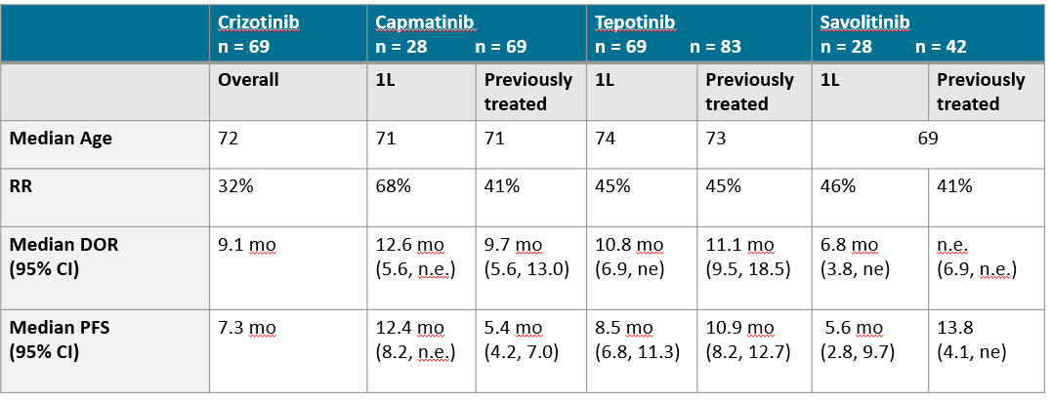
Type I MET inhibitors in MET exon 14 skipping
Drilon et al Nat Med 2019; Wolf et al NEJM 2020; Paik et al WCLC 2020; Lu et al ASCO 2020

Slide 18
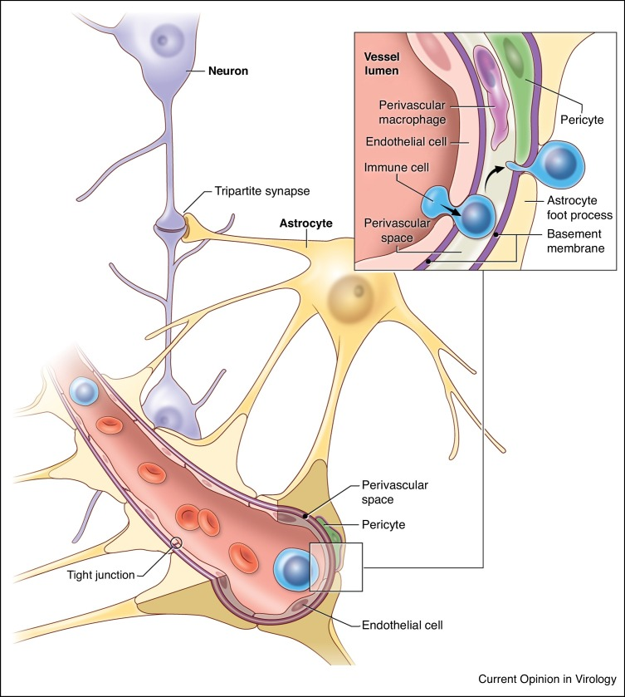
Blood Brain Barrier
Some cancer drugs have difficulty entering the brain due to this ‘barrier’
Crizotinib is an example where relatively lower effectiveness in brain metastases has been observed
Costa et al JCO 2011
Manglani et al Curr Opin Virol 2018

Slide 19
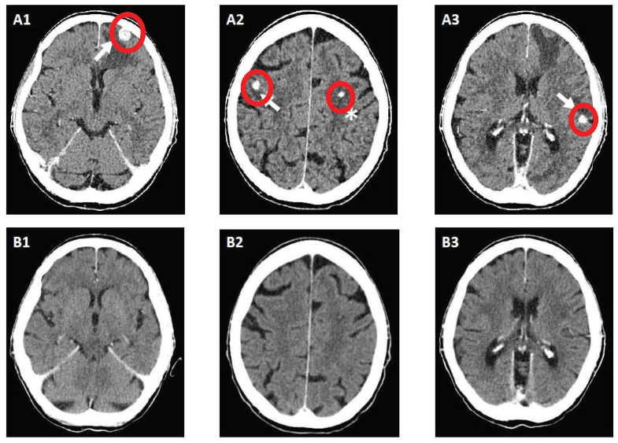
CNS Activity – Capmatinib and Tepotinib
Capmatinib, 54% (n=7/13) intracranial response
  Intracranial disease control achieved in 12/13 patients
Tepotinib, 55% (n=6/11) intracranial response
Wolf et al NEJM 2020

Slide 20
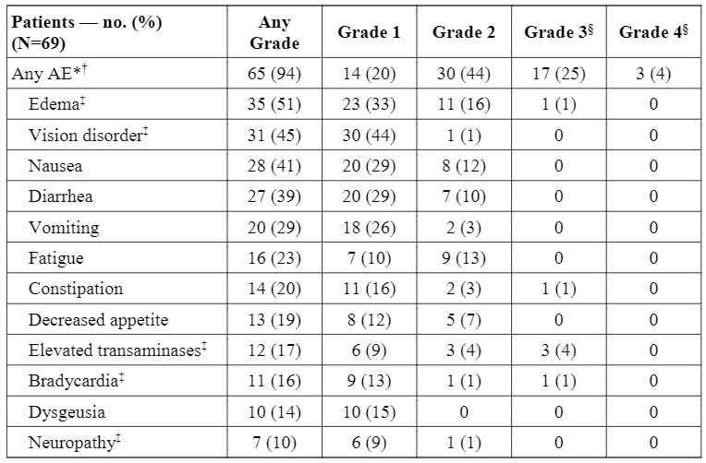
Crizotinib
- Safety
Adverse events led to a dose reduction in 38% of patients and discontinuation in 7%
Drilon et al, Nat Medicine 2019
Content Slide – Title Only

Slide 21
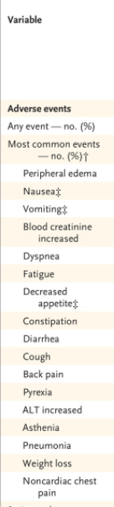
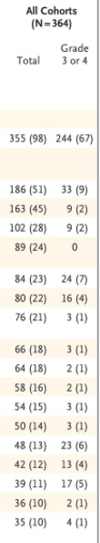
Capmatinib
- Safety
Most common were peripheral edema and GI effects
Adverse events led to a dose reduction in 23% of patients and discontinuation in 11%
Wolf et al NEJM 2020
Content Slide – Title Only

Slide 22
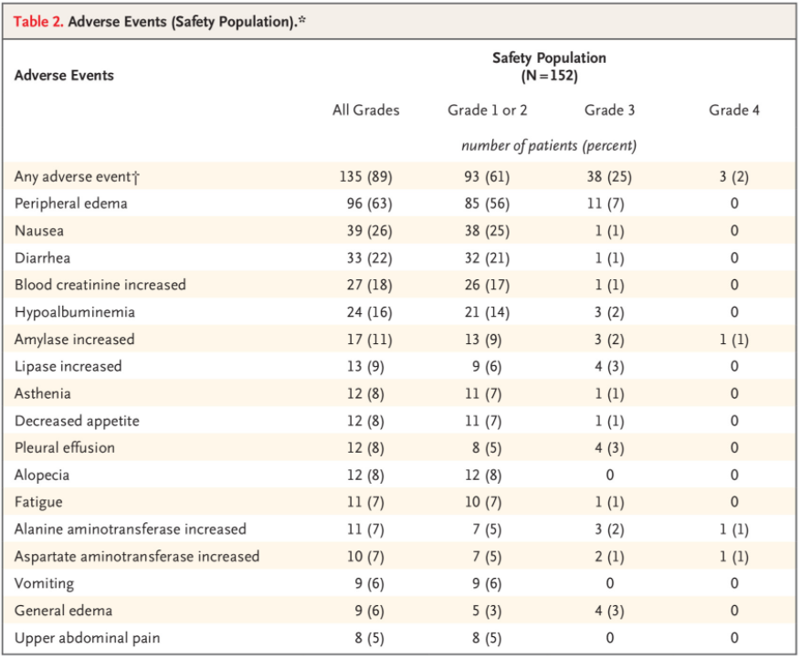
Tepotinib
- Safety
Median time to onset of events was 3-11 weeks after initiation
Led to a dose reduction in 33% of patients and discontinuation in 11%
Paik et al NEJM 2020
Content Slide – Title Only

Slide 23
Capmatinib- Practical concerns
Capmatinib starting dose: 400 mg orally twice daily
  Available in 200 mg or 150 mg tablets
  Can be taken with or without food
Elimination half-life of capmatinib - 6.5 hours
Content Slide – NOTE: there are a full set of Content Slide layouts for you to utilize.
NOTE: The orange color in the palette can be used for callouts

Slide 24
Tepotinib- Practical concerns
Tepotinib starting dose: 450 mg orally once daily
  Available in 225 mg tablets
  Should be taken with food
Elimination half-life of tepotinib - 32 hours
Content Slide – NOTE: there are a full set of Content Slide layouts for you to utilize.
NOTE: The orange color in the palette can be used for callouts

Slide 25
MET TKIs - Practical concerns
Labs including liver function tests should be checked prior to and during therapy
Let your oncologist know if you develop shortness of breath or respiratory symptoms
For edema, compression stockings and leg elevation are recommended; diuretics not always helpful
Be aware of potential drug interactions (including grapefruit!)
Content Slide – NOTE: there are a full set of Content Slide layouts for you to utilize.
NOTE: The orange color in the palette can be used for callouts

Slide 26
Conflict of Interest
Dr. Xiuning Le receives consulting/advisory fees from EMD Serono (Merck KGaA), AstraZeneca, Spectrum Pharmaceutics, Eli Lilly, Boehringer Ingelheim, Bristol-Myers Squibb and Celgene, and Research Funding from Eli Lilly and Boehringer Ingelheim.
Dr. Andreas Saltos has received travel reimbursement from Daiichi Sankyo, and research funding (to his institution) from Novartis, Daiichi Sankyo, Eli Lilly, Mersana, Genmab, AstaZeneca and Turning Point Therapeutics.
Dr. Heist has received honoraria for consulting/advisory boards from Novartis, EMD Serono, Daichii Sankyo, Tarveda, Apollomics, Boehringer Ingelheim. She has also received research funding (to institution, not to self) from Novartis, Daichii Sankyo, Genentech/Roche, Mirati, Turning Point, BMS, Agios, Corvus, Abbvie, Incyte, Corvus, Lilly

Slide 27
Logo Slide 1

