Slide 1

Treatment Options Beyond MET Targeted Therapy
Xiuning le md phd (MD Anderson Cancer Center)
Mark awad MD phd (dana-farber cancer institute)
Karen reckamp md (Cedars-sinai medical center)
john hallick (MET crusaders)
Title Slide – Single Presenter

Slide 2
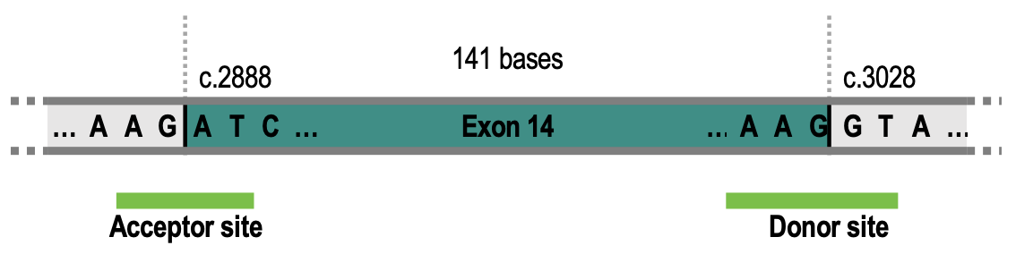
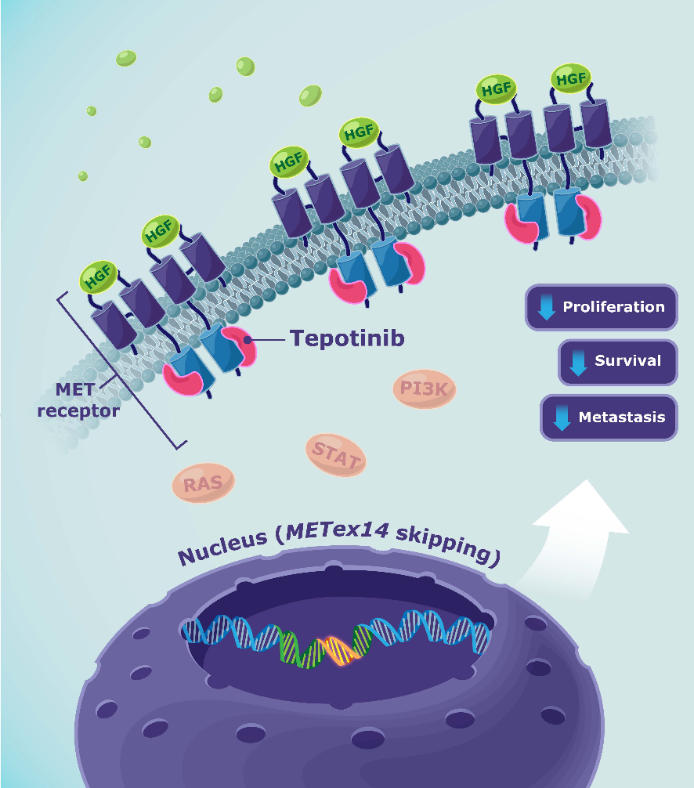
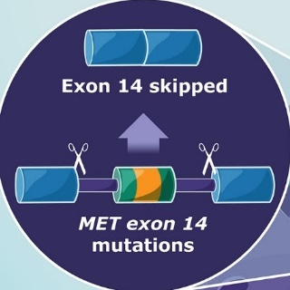
METex14 as an oncogene driver in lung cancer
MET exon 14 skipping
Chr7:116411903
c.2888
Chr7:116412043
c.3028

Slide 3
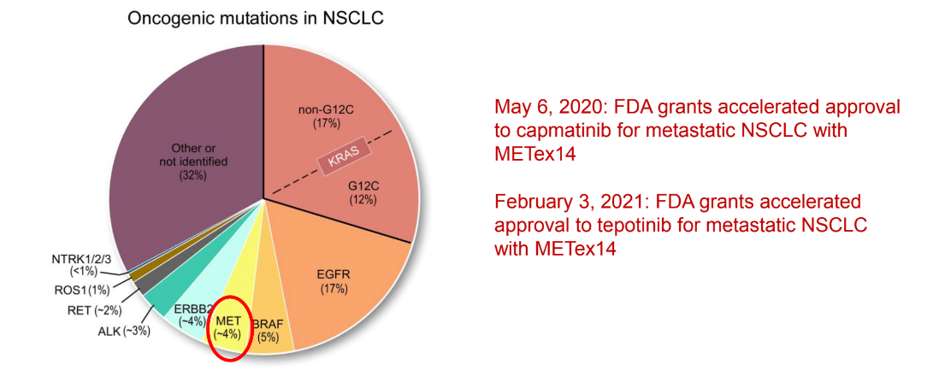
FDA approved MET therapies
Content Slide – Title Only

Slide 4
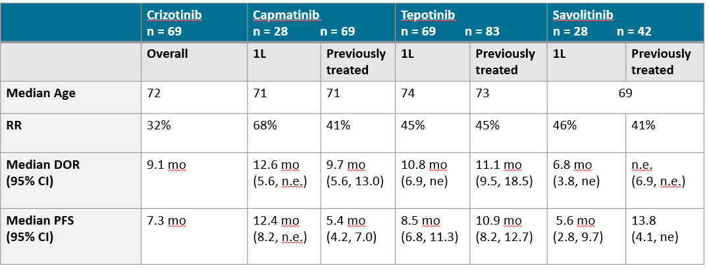
Type I MET inhibitors in MET exon 14 skipping
Drilon et al Nat Med 2019; Wolf et al NEJM 2020; Paik et al WCLC 2020; Lu et al ASCO 2020

Slide 5
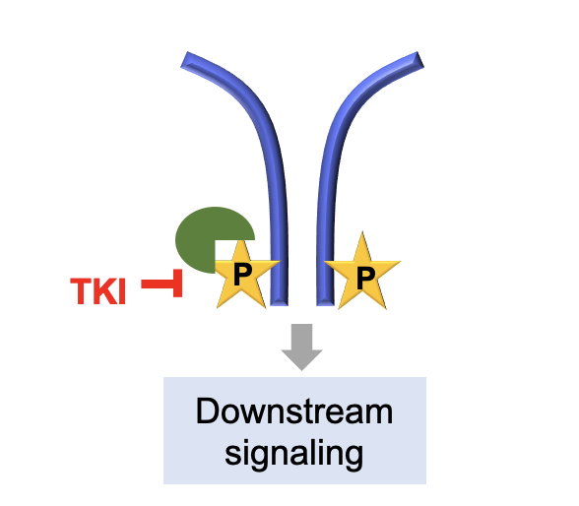
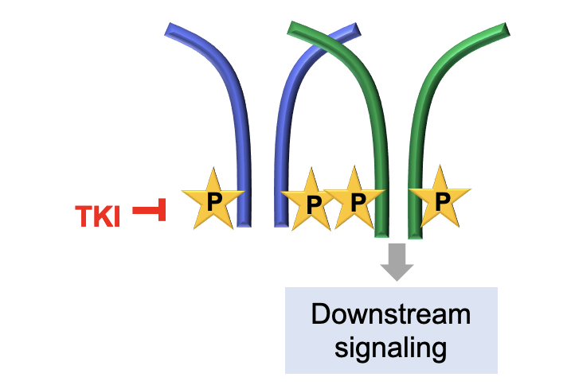
Resistance mechanisms to MET TKI
For most TKI, there are at least three classes of resistance mechanisms
Pathway re-activation
Bypass pathway activation
Non-genetic
For example, small cell transformation
acquired new resistant driver
secondary mutation within the oncogene

Slide 6
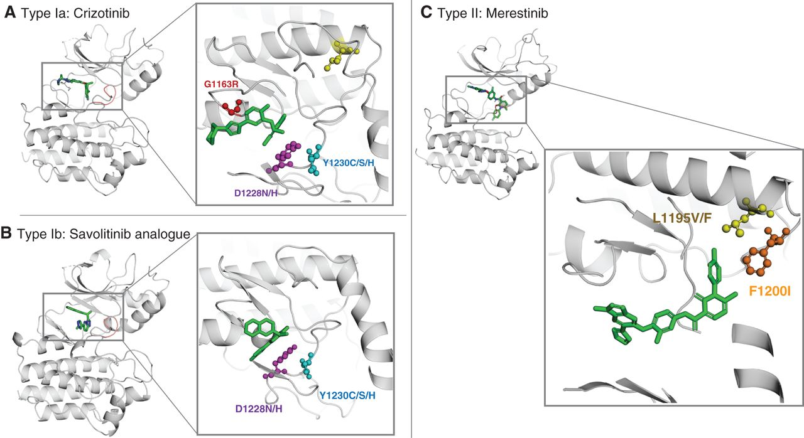
MET re-activation due to new MET mutations
After type I (capmatinib/tepotinib)
D1228, Y1230
can respond to type II TKI
After type II (cabozantinib/merestinib)
L1195, F1200
Can respond to type I TKI
Recondo et al Cancer Discovery 2020

Slide 7
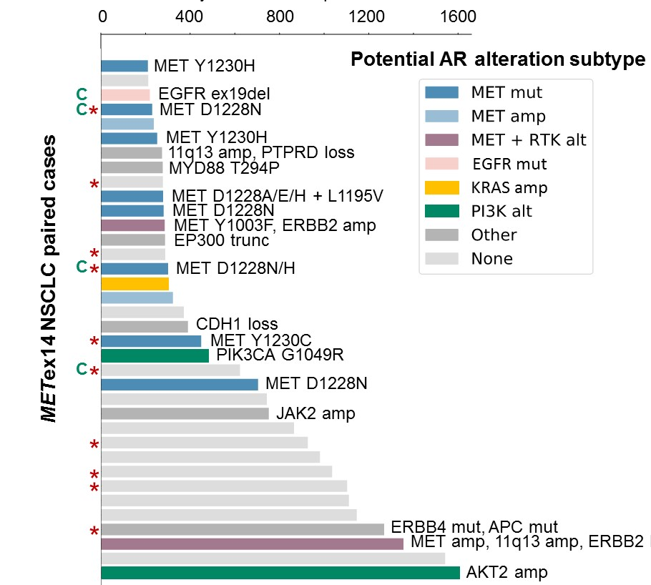
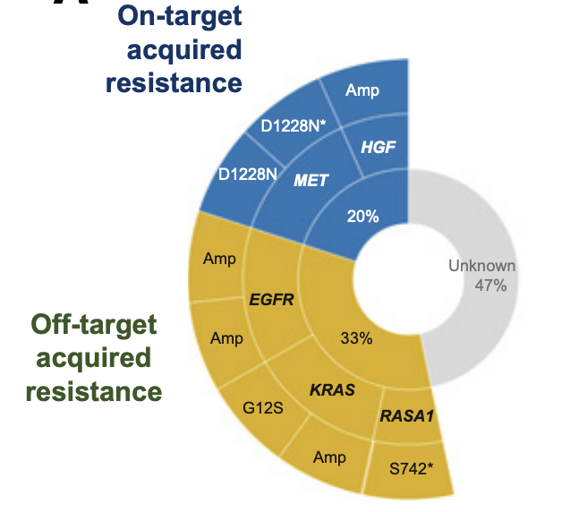
Bypass pathway activation
EGFR mutation or amplification
KRAS mutation or amplification
PIK3CA mutation
Rare fusions, ALK, RET
MET pathway re-activation
Bypass pathway activation
N=15
Guo et al 2020 CCR
Awad et al 2020 ASCO

Slide 8
Resistance mechanisms to MET TKI
15-20% MET new mutations
30-40% EGFR/RAS/PI3K
40-50% non-driver
Pathway re-activation
Bypass pathway activation
Non-genetic
For example, small cell transformation
acquired new resistant driver
secondary mutation within the oncogene

Slide 9
Potential post MET TK inhibitor therapy for MET ex14 NSCLC
Clinical history, patient characteristics, and tumor data reviewed by multidisciplinary team
Workup should include imaging, pathology for histological subtype, molecular testing using a broad-based panel, and immunohistochemistry to determine PD-L1 status
Considerations in choosing treatment:
Disease characteristics—PD-L1 expression, molecular results, bulky disease or rapidly progression
Patient characteristics—performance status, comorbidities, other contraindications, patient goals
Diagnosis and
assessment
Squamous Cell
Non-squamous Cell
Patient
Section
PD-L1 TPS <1%
PD-L1 TPS 1-49%
PD-L1 TPS ≥50%
PD-L1 TPS <1%
PD-L1 TPS 1-49%
PD-L1 TPS ≥50%
Ipilimumab/ nivolumab*
Atezolizumab; Cemiplimab
Ipilimumab/ nivolumab*
Atezolizumab; Cemiplimab
Pembrolizumab + carboplatin/
nab-paclitaxel or paclitaxel
Atezolizumab + carboplatin/nab-paclitaxel;
Pembrolizumab + carboplatin/ pemetrexed;
Atezolizumab + carboplatin/ paclitaxel and bevacizumab
Treatment
Recommendations
Pembrolizumab
Pembrolizumab
Ipilimumab/ nivolumab + 2 cycles carboplatin/paclitaxel
Ipilimumab/ nivolumab + 2 cycles carboplatin/paclitaxel
Treatment
Cessation
Treatment until response, progression, or unacceptable toxicities
* Not FDA approved for PD-L1 <1%
Adapted from Brahmer JR, et al. J Immunother Cancer. 2018;6:75 and Hanna NH, et al. J Clin Oncol. 2020;38:168-1632.

Slide 10
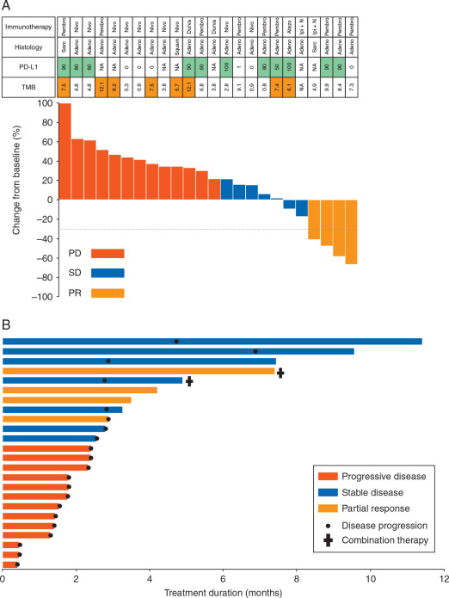
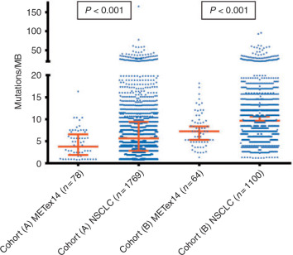
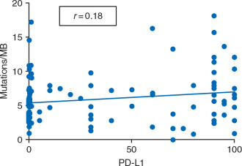
Use MET TKI in clinical practice
Sabari JK et al Ann Oncol 2018

Slide 11
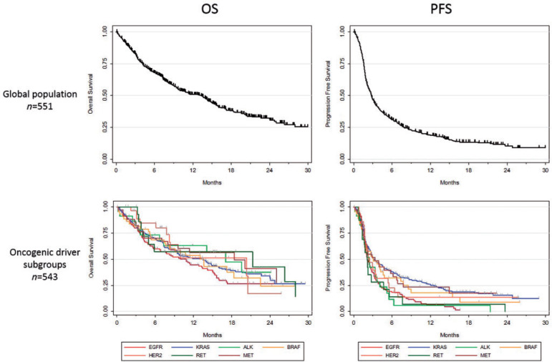
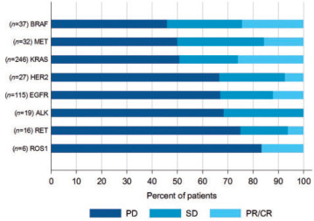
MET TKI in clinical practice—response to ICI
Mazieres J et al Ann Oncol 2019

Slide 12
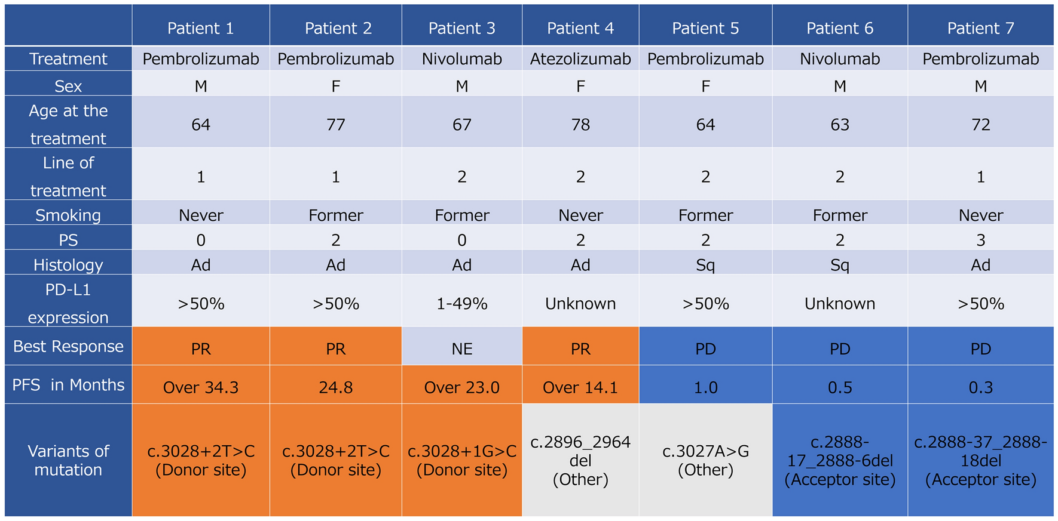
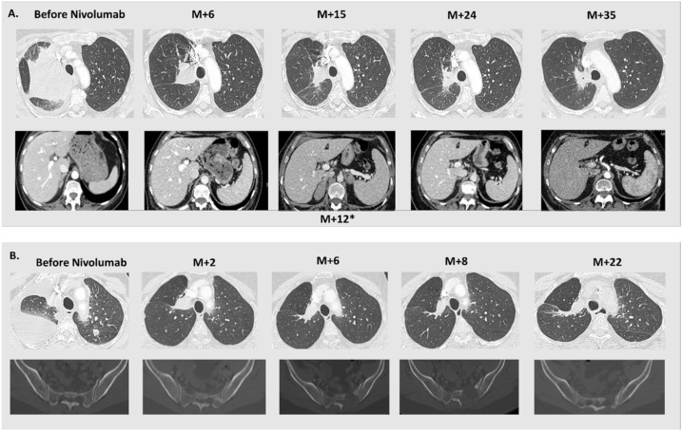
MET TKI in clinical practice—response to ICI
46% benefit to ICI
Kato Y et al Int J Clin Oncol 2021; Mayenga M et al Lung Cancer 2020

Slide 13
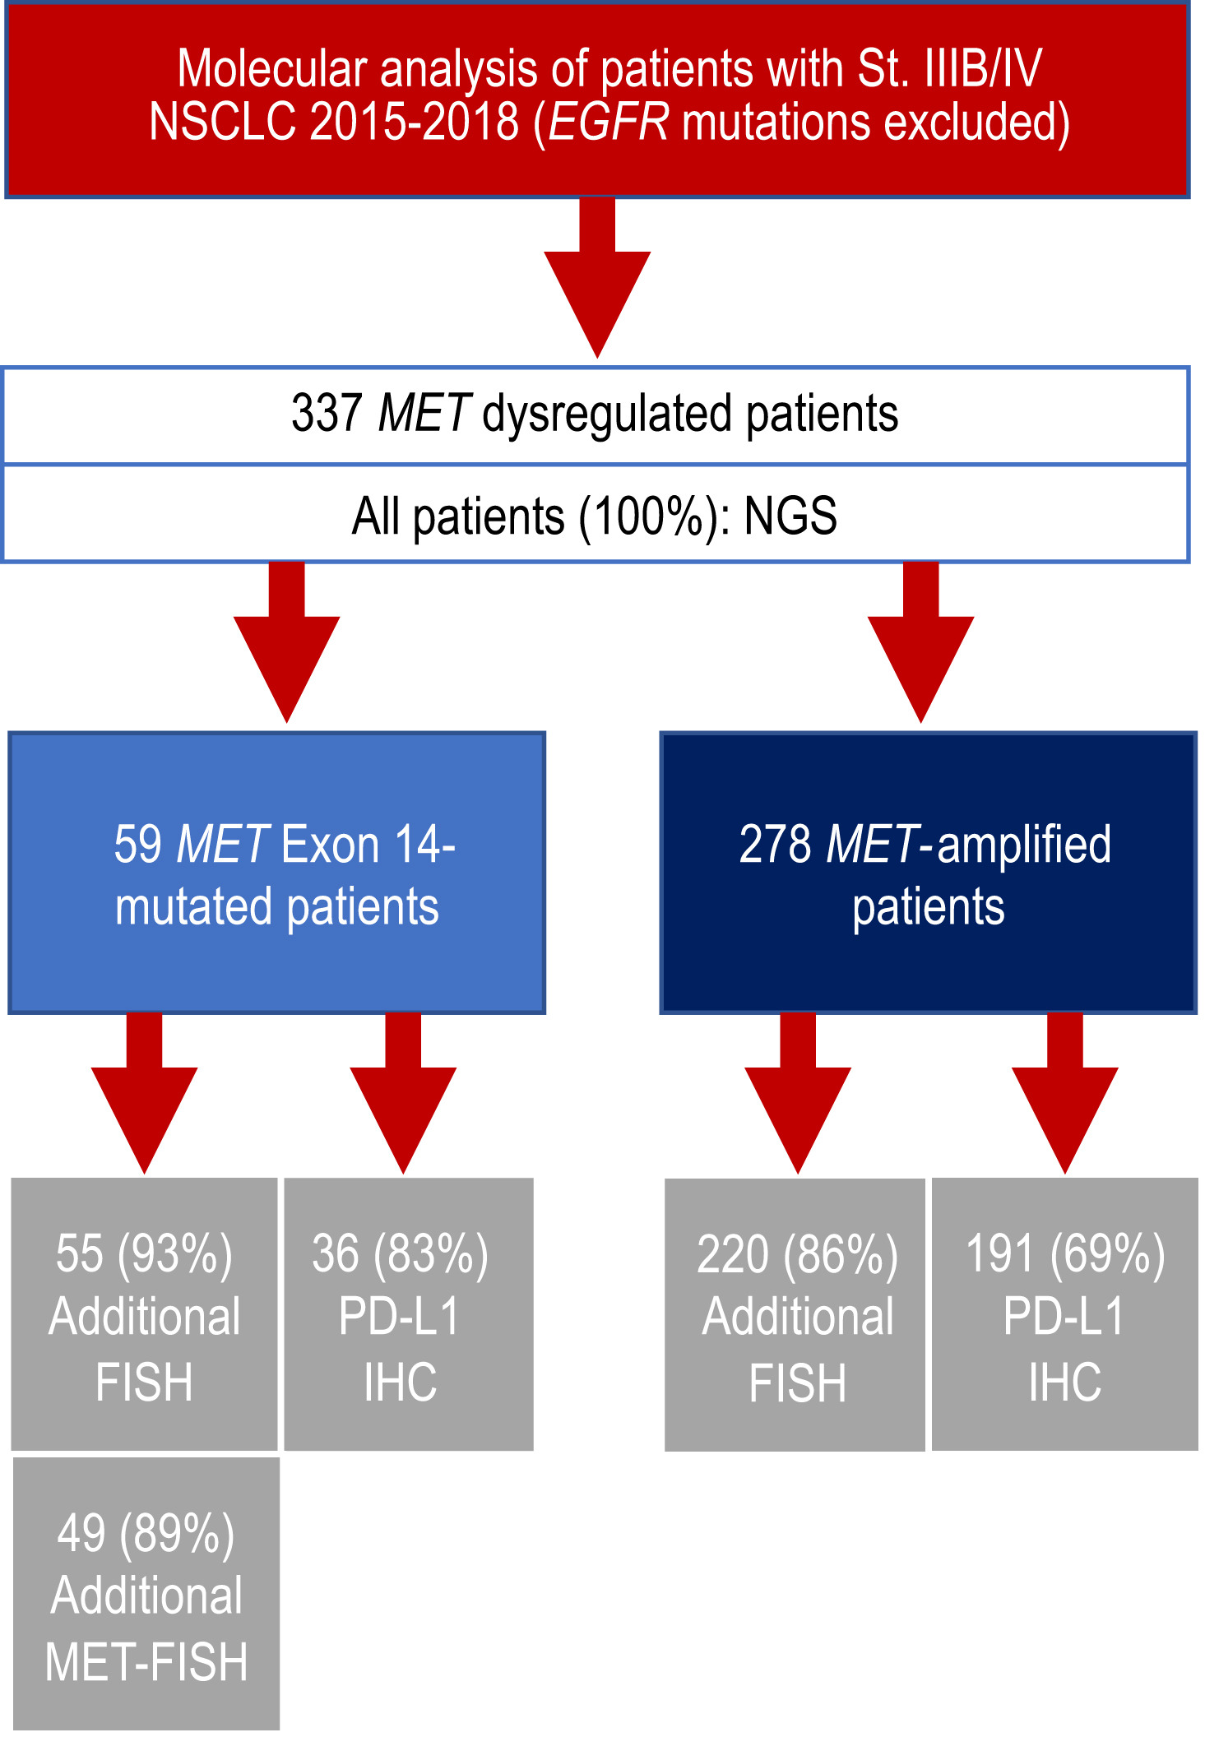
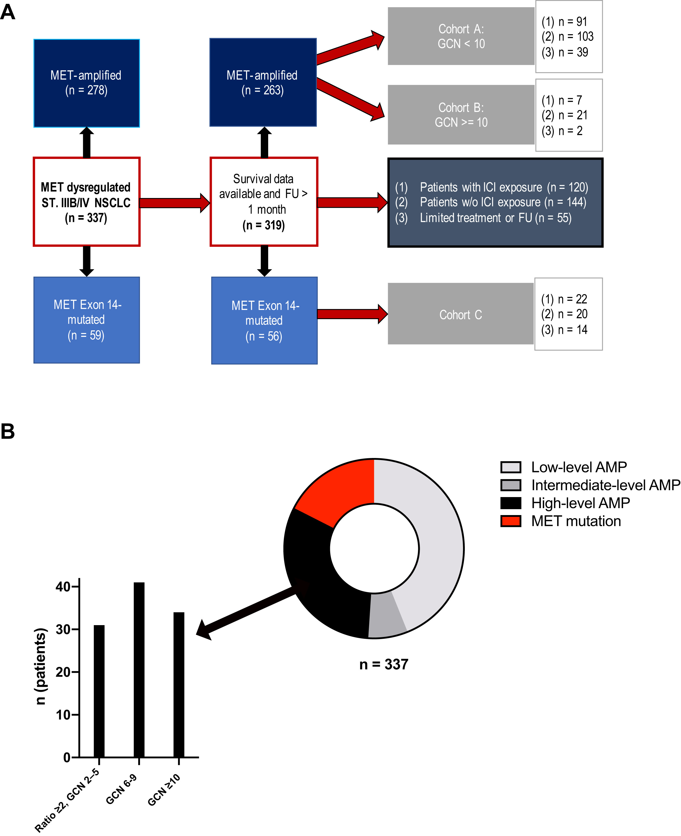
MET TKI in clinical practice—MET alterations
Kron A et al. J Thorac Oncol 2020; 10.1016/j.jtho.2020.11.017

Slide 14
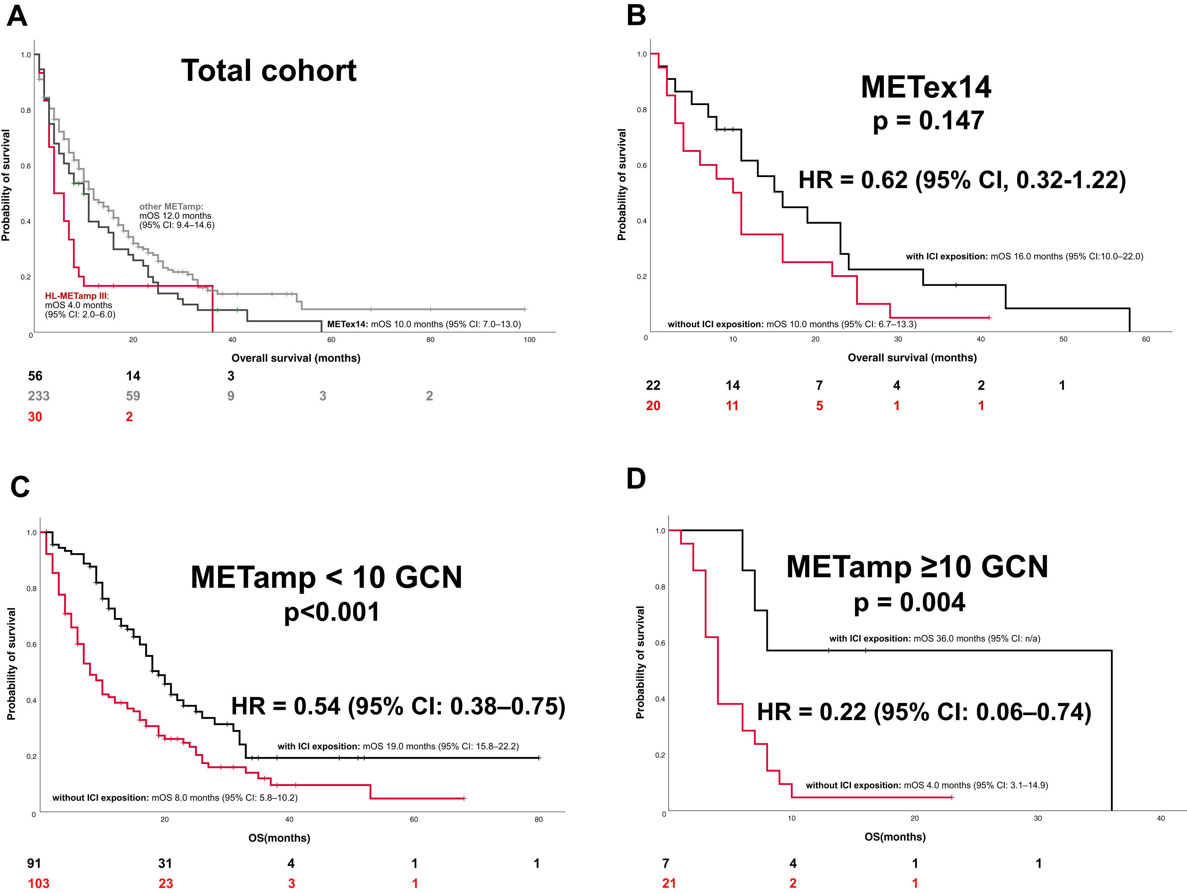
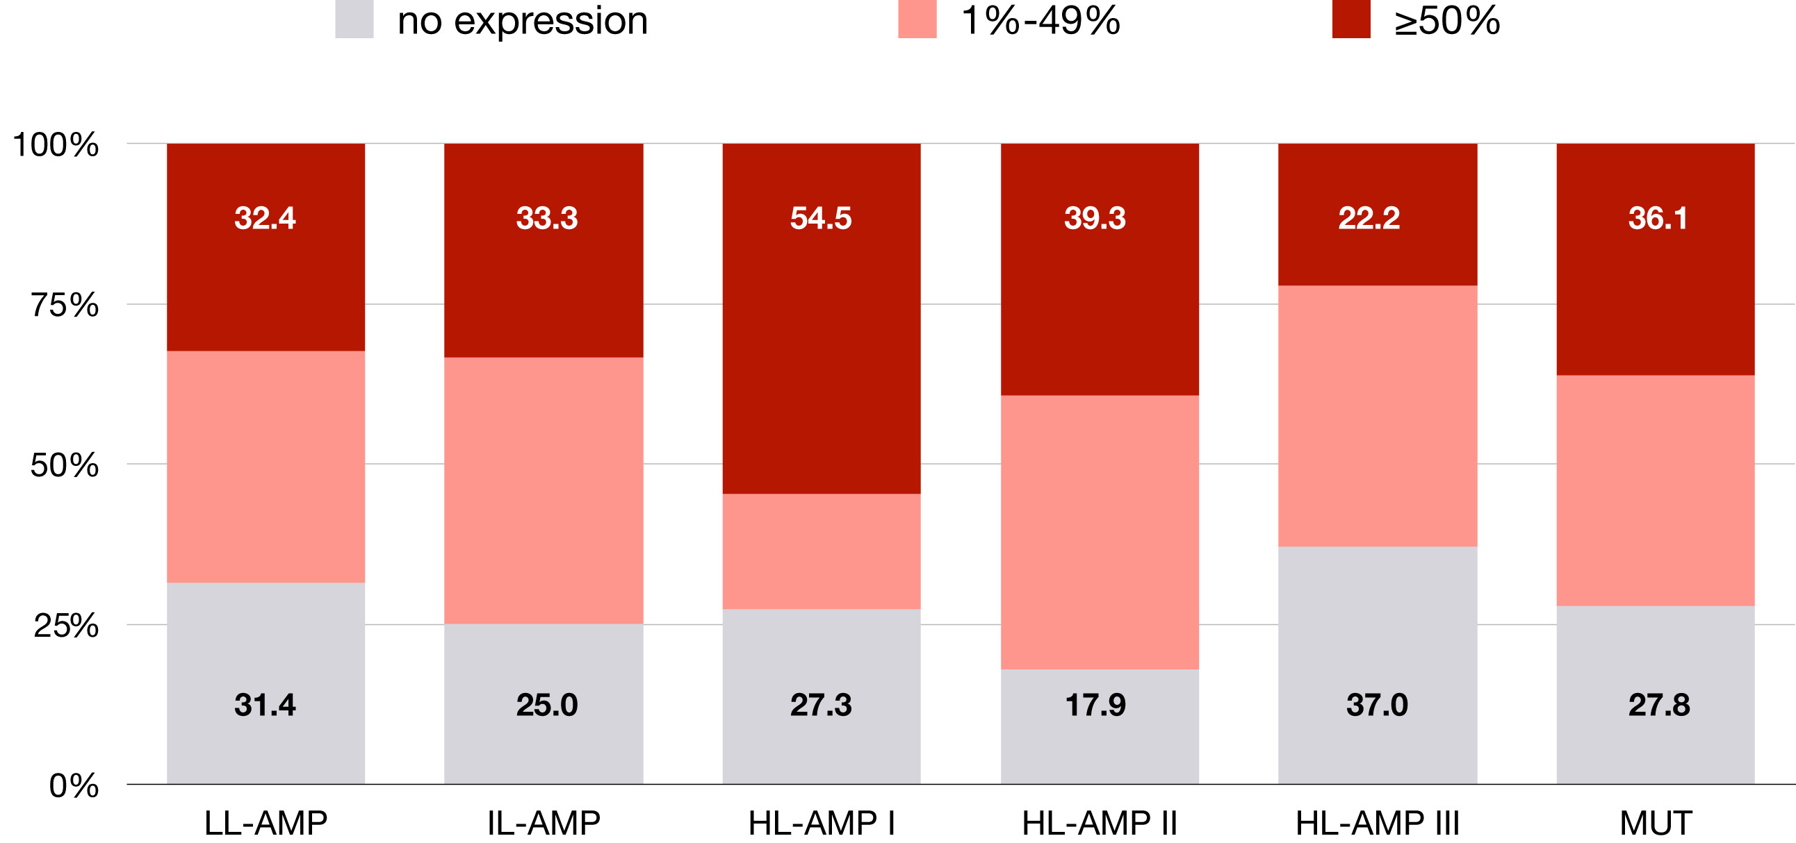
MET TKI in clinical practice—PD-L1 expression
Kron A et al. J Thorac Oncol 2020; 10.1016/j.jtho.2020.11.017

Slide 15
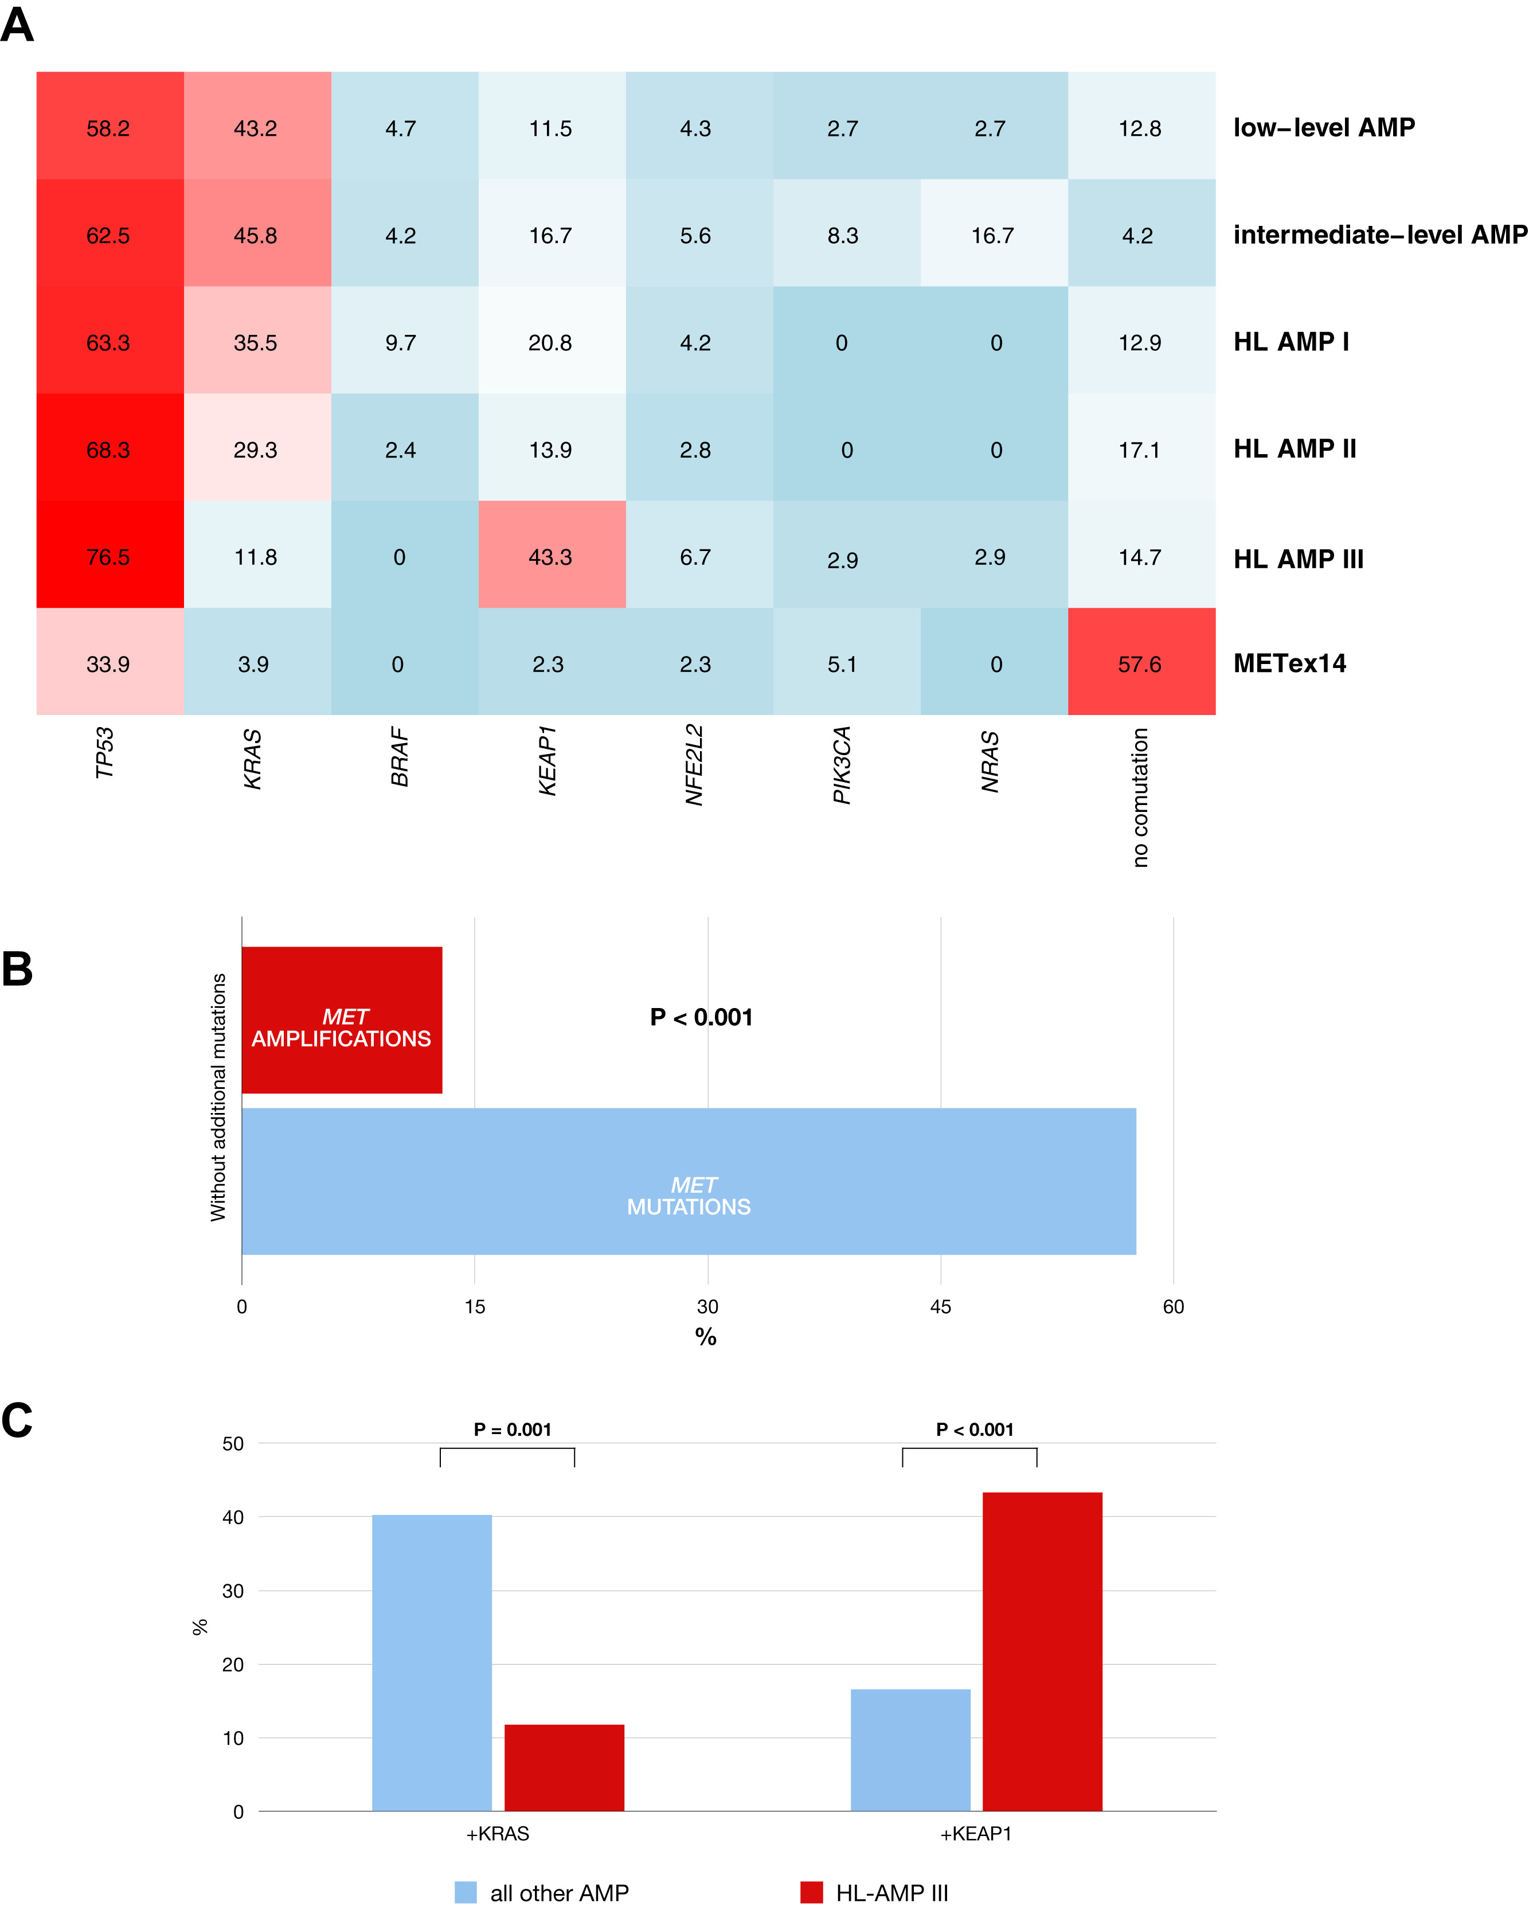
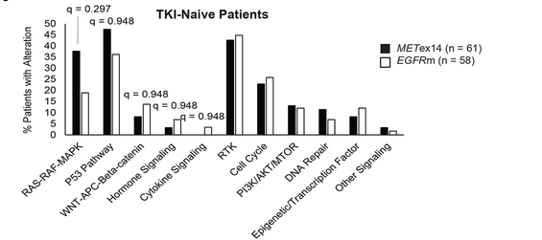
MET TKI in clinical practice—co-mutations
Targeted sequencing analysis of co-occurring genomic alterations in cell-free circulating tumor DNA samples collected from patients with MET exon 14–mutated advanced NSCLC (N = 289)
  Activating KRAS mutations: 5.2%
    KRAS G12C/D/S/V, 3.5%; G13C, 1%; Q22K, 0.3%; Q61H, 0.3%
  Canonical activating EGFR mutations: 3.5%
    EGFR del19, 3.1%; L858R, 0.7%; T790M, 2%
  ALK rearrangement: 0.7%
  HER2 exon 20 insertion identified in 1 patient
Kron A et al. J Thorac Oncol 2020; 10.1016/j.jtho.2020.11.017; Rotow J et al Clin Cancer Res 2020

Slide 16
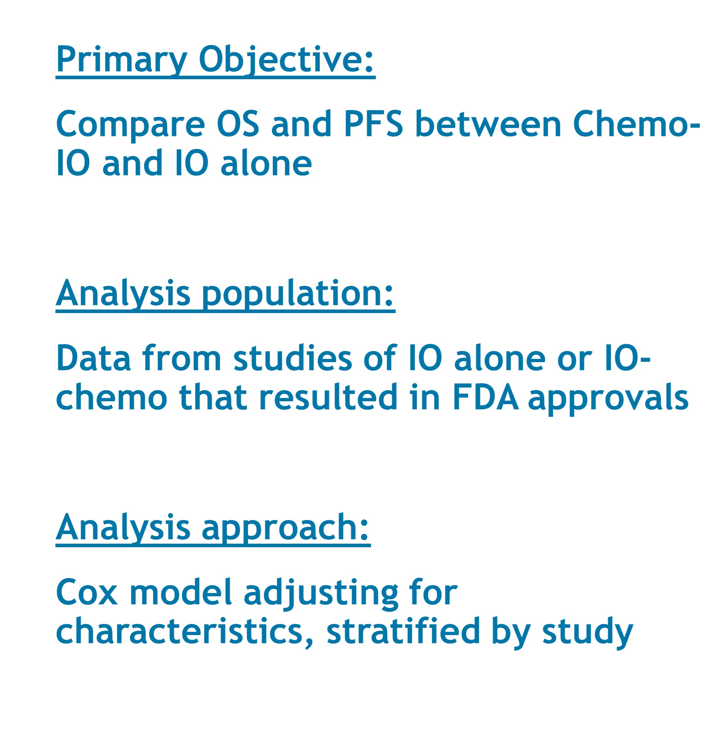
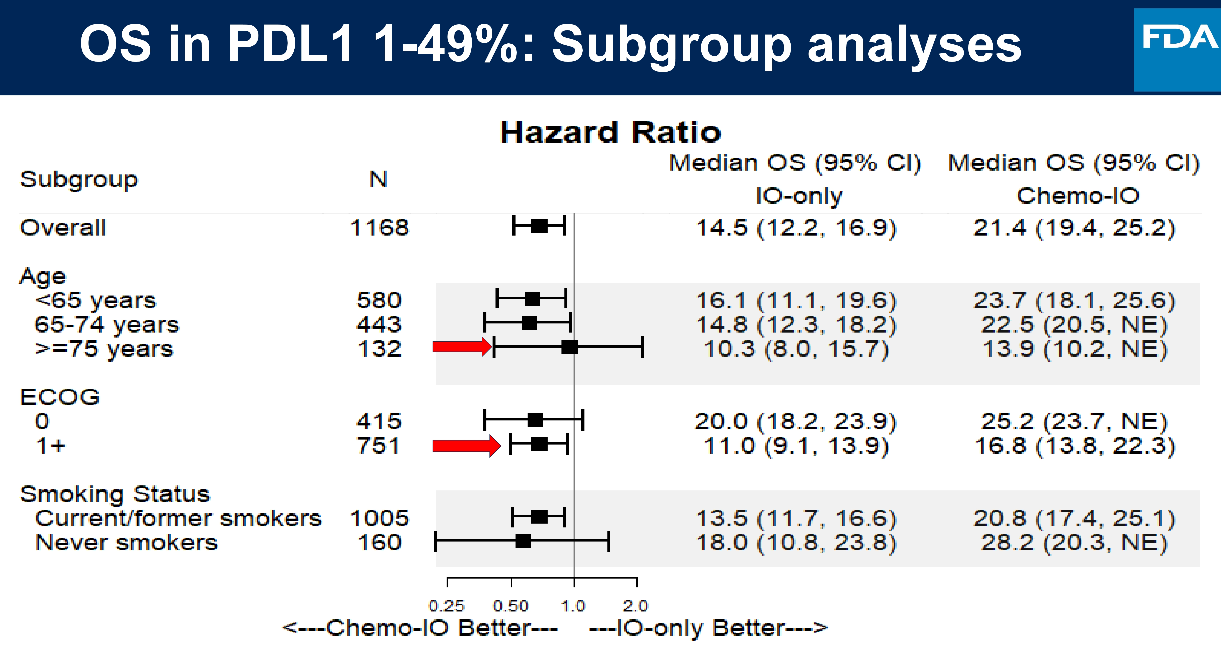
MET TKI in clinical practice—choices post TKI
FDA analysis comparing chemo-ICI and ICI alone in PD-L1 1-49%
Akinboro O et al. ASCO 2021

Slide 17
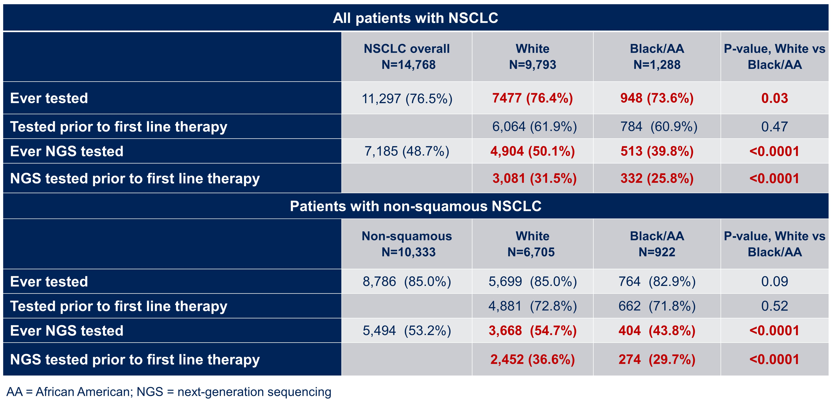
MET TKI in clinical practice—Biomarker testing
Patients that don’t have testing will never be treated with the appropriate targeted therapy
Bruno D et al. ASCO 2021
Notes:
cfDNA, cell-free DNA; NSCLC, non-small-cell lung cancer.

Slide 18
MET TKI in clinical practice—NILE Study
Guideline-Recommended Biomarkers, % | The Cancer Genome Atlas | cfDNA |  | Tissue
 |  | Total Cohort | Frequency of Alteration* | Total Cohort | Frequency of Alteration*
EGFR mutation | 11.3 | 15.2 | 16.0 | 14.2 | 17.3
ALK fusion | 1.3 | 2.1 | 2.2 | 3.2 | 4.0
ROS1 fusion | 1.7 | 0 | 0 | 0.7 | 1.2
BRAF mutation (V600E) | 7.0 | 0.7 | 0.7 | 0.7 | 2.1
RET fusion | 0.9 | 1.1 | 1.1 | 0 | 0
ERBB2 mutation | 1.7 | 1.1 | 1.1 | 0.4 | 1.6
MET exon 14 skipping variant | 4.3 | 3.5 | 3.7 | 1.8 | 7.5
MET amplification MET focal amplification MET aneuploidy | 2.2 | 5.3 1.8 3.5 | 5.6 1.9 3.7 | 0.4 | 1.6
KRAS mutation | 32.2 | 31.6 | 33.2 | 8.5 | 32.9
*In patients with completed testing for biomarker of interest.
Biomarker frequency calculated across the entire cohort (n = 282)
Leighl. Clin Cancer Res. 2019;25:4691.
Notes:
cfDNA, cell-free DNA; NSCLC, non-small-cell lung cancer.

Slide 19
MET TKI in clinical practice—VISION
Efficacy Outcomes | Liquid Biopsy (L+) |  |  | Tissue Biopsy (T+)
 | IRC (n = 48) |  | Investigator (n = 47) | IRC (n = 51) | Investigator (n = 51)
BOR by RECIST 1.1, n (%)
CR | 0 (0) | 0 (0) | 3 (6.4) | 0 (0) | 3 (5.9)
PR | 24 (50.0) | 24 (50.0) | 23 (48.9) | 23 (45.1) | 25 (49.0)
SD | 8 (16.7) | 8 (16.7) | 5 (10.6) | 14 (27.5) | 11 (21.6)
PD | 7 (14.6) | 7 (14.6) | 10 (21.3) | 8 (15.7) | 6 (11.8)
Not evaluable | 9 (18.8) | 9 (18.8) | 6 (12.8) | 6 (11.8) | 6 (11.8)
ORR,* n (%; 95% CI) | 24 (50.0; 35.2-64.8] | 24 (50.0; 35.2-64.8) | 26 (55.3; 40.1-69.8) | 23 (45.1; 31.1-59.7) | 28 (54.9; 40.3-68.9)
Median DoR, mos (95% CI) | 12.4 [5.8-NE] | 12.4 (5.8-NE) | 17.1 (7.2-NE) | 15.7 (9.0-NE) | 14.3 (5.7-NE)
DCR,† n (%; 95% CI) | 32 (66.7; 51.6-79.6] | 32 (66.7; 51.6-79.6) | 31 (66.0; 50.7-79.1) | 37 (72.5; 58.3-84.1) | 39 (76.5; 62.5-87.2)
*CR + PR. †Confirmed CR/PR or SD for ≥ 12 wks.
Efficacy analysis includes patients having ≥ 2 postbaseline assessments or who discontinued treatment for any reason.
L+, METex14-skipping mutation-positive in ctDNA; T+ METex14-skipping mutation–positive in tissue.
Paik. NEJM 2020; Paik. ASCO 2019. Abstr 9005.
Notes:
BOR, best overall response; DCR, disease control rate; DoR, duration of response; IRC, Independent Review Committee; NE, not estimable; PD, progressive disease; RECIST, Response Evaluation Criteria in Solid Tumors; SD, stable disease.

Slide 20
MET TKI in clinical practice—post TKI trials
NIH Identifier: NCT02323126
Link: https://clinicaltrials.gov/ct2/ show/NCT02323126
Title: Study of Efficacy and Safety of Nivolumab in Combination with EGF816 and of Nivolumab in Combination With INC280 in Patients With Previously Treated Non-small Cell Lung Cancer (EGF816)
NIH Identifier: NCT04310007
Link: https://clinicaltrials.gov/ct2/ show/NCT04310007
Title: Phll Chemotherapy, Cabozantinib, to the Standard Immune Therapy Nivolumab Compared to Standard Chemotherapy for Non-small Cell Lung Cancer
NIH ID: NCT02954991
Link: https://clinicaltrials.gov/ct2/ show/NCT02954991
Title: Phase 2 Study of Glesatinib, Sitravatinib or Mocetinostat in Combination with Nivolumab in Non-Small Cell Lung Cancer
NIH ID: NCT03666143
Link: https://clinicaltrials.gov/ct2/ show/NCT03666143
Title: A Phase 1b Study to Assess Sitravatinib in Combination with Tislelizumab in Patients With Advanced Solid Tumors
NIH ID: NCT04323436
Link: https://clinicaltrials.gov/ct2/ show/NCT04323436
Title: Study of Capmatinib and Spartalizumab/Placebo in Advanced NSCLC Patients with MET Exon 14 Skipping Mutations
NIH ID: NCT04139317
Link: https://clinicaltrials.gov/ct2/ show/NCT04139317
Title: Safety and Efficacy of Capmatinib (INC280) Plus Pembrolizumab vs Pembrolizumab Alone in NSCLC With PD-L1≥ 50%

Slide 21
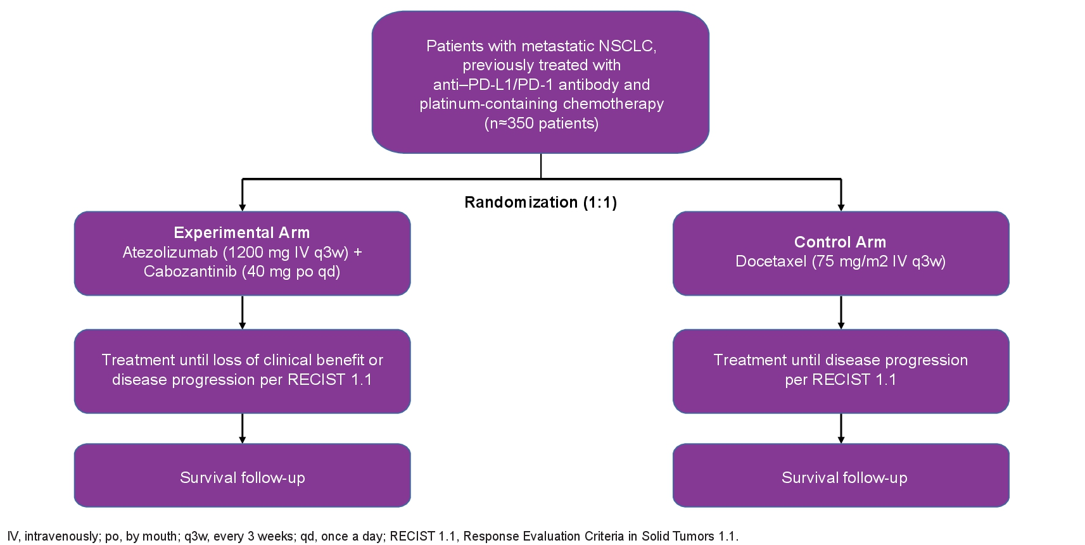
MET TKI in clinical practice—ICI trials
Contact-01 Study design
NCT04471428
Neal JW et al. ASCO 2021 abstract TPS9134

Slide 22
Conflict of Interest
Dr. Xiuning Le receives consulting/advisory fees from EMD Serono (Merck KGaA), AstraZeneca, Spectrum Pharmaceutics, Novartis, Hengrui, Eli Lilly, Daiichi Sankyo, Boehringer Ingelheim, and Bristol-Myers Squibb, and Research Funding from Eli Lilly and Boehringer Ingelheim.
Dr. Mark Awad reports grants and personal fees from Genentech, grants and personal fees from Bristol-Myers Squibb, grants and personal fees from AstraZeneca, grants from Lilly, and personal fees from Merck, Maverick, Blueprint Medicine, Syndax, Ariad, Nektar, Gritstone, ArcherDX, Mirati, NextCure, Novartis, EMD Serono, Panvaxal/NovaRx.
Dr. Karen Reckamp receives consulting/advisory fees from Amgen; AstraZeneca; Bluprint; Boehringer Ingelheim; EMD Serono; Genentech; GSK; Guardant; Janssen; Lilly; Loxo; Mirati Seattle Genetics; Takeda, and research funding to the institution from AbbVie, Acea, Adaptimmune, Boehringer Ingelheim, Bristol Myers Squibb, Calithera; Daiichi Sankyo; Elevation Oncology Genentech, GlaxoSmithKline, Guardant, Janssen, Loxo Oncology, Seattle Genetics, Takeda, Xcovery, Zeno

Slide 23
Logo Slide 1

